Slide 1
Cinekids Brief Art Work
Inspired by the Down The Rabbit Hole season of events I am organising for the Family Arts Festival

Slide 2
Stop-motion animation inspiration
Follow the White Rabbit: Begin animation with the white rabbit/Alice falling down the Rabbit Hole http://www.youtube.com/watch?v=uVZssBBFtZ8
Animate original-style Alice drawings (or my own mixed media versions of them e.g. painted / silhouettes on paper or using light projection behind tissue paper background / made into 3D sculptures in a set)
Use a mixture of characters from different Alice versions (e.g. Carroll’s / Disney / 2010) in a short narrative/conversation
Falling down the rabbit hole – passing clocks / tea cups / a grand piano etc… Could be good to animate this. Use of perspective. Beginning with the rabbit hole opening up (being drawn as if it is getting bigger and bigger) / cutting a hole in paper to reveal more brown underneath?

Slide 3
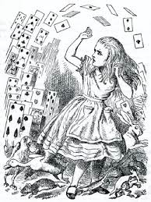
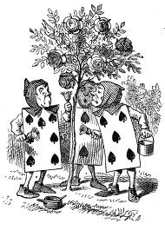
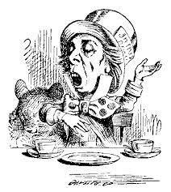
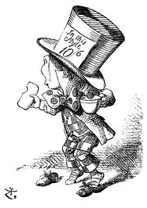
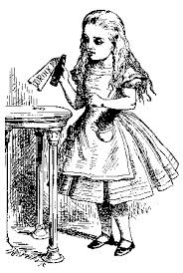
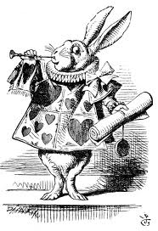
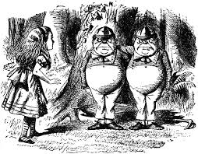

Slide 4
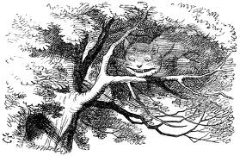
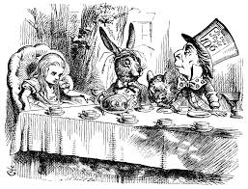
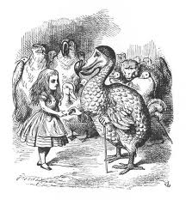
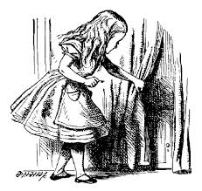
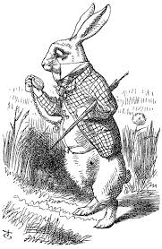

Slide 5
Inspiring stop motion/animated films
http://www.youtube.com/watch?v=QzxXQhMZHHo
http://vimeo.com/67774633
https://www.youtube.com/watch?v=xzQWgv5sNm4
http://www.youtube.com/watch?v=kSwz01n8bhc
Shoe (2008) http://www.youtube.com/watch?v=wz0rt8HIl0s
Scary but amazing! http://www.youtube.com/watch?v=Uj4RBmU-PIo

Slide 6
Stop motion tips
Get the camera close and use a variety of shots if possible. Zoom in and out if you don’t want to move the camera.
Have a clear beginning, middle and end.
Have multiple things happening in one shot and make things move at different times.
Use text to narrate your story?

Slide 7
Sources
Stop motion tips: http://stopmotionexplosion.com/blogs/blog/6394410-6-stop-motion-beginner-mistakes-and-how-to-avoid-them
http://www.stormthecastle.com/stop-motion-animation/Nine-creative-techniques-for-stop-motion-animation.htm

