Slide 1
Down The Rabbit Hole - Film Screening + Workshop
Sat 2 Nov 13:00/13:30

Slide 2
Idea 1 - General
Short films and animations based on adventure/imagination/magic, followed by a stop-motion animation workshop for kids and grown ups using mixed media. Everyone making a character for the set of their adventure and then animating a short story.
Copy: ‘a kaleidoscopic showcase…’
Pervasive Media Studio engagement – Presented by Watershed’s Pervasive Media Studio?
Workshop with Rose?

Slide 3
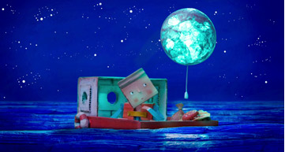
Idea 1 – Short films
Balloon Moon
Portugal, Animation, Jose Miguel Ribeiro, 2010, 5 min With sumptuous colors and artful stop motion animation, a cardboard boy and his ladybug friend set sail into a deep blue moonlit sea and have a dream adventure.

Slide 4
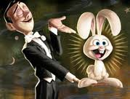
Idea 1 – Short films
Pesto
Animation, Pixar, 2008, 5 min
A comedy treat in which a stage magician and his white rabbit battle it out during a magic show.

Slide 5
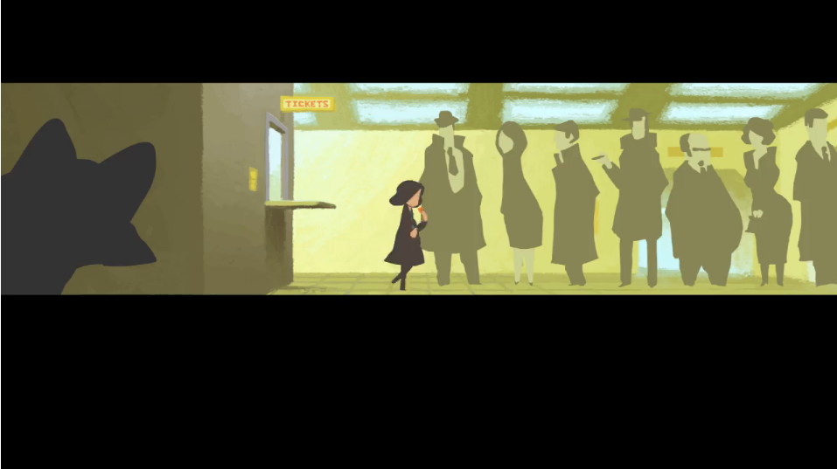
Idea 1 – Short films
Metro
Animation, Jake Wyatt, 2011, 5 min
A young girl chases a mysterious fox through a secret door and into a subterranean wonderland to retrieve her stolen train ticket.

Slide 6
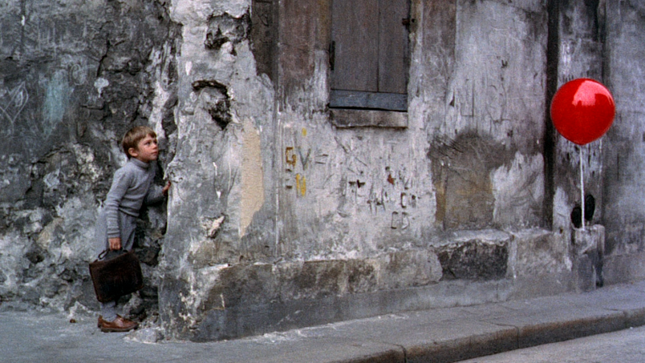
Idea 1 – Short films
The Red Balloon
French, Pascal Lamorisse, 1956, 34 min
This enchanting short film about a red balloon that befriends a little French boy is more than a joy to watch.

Slide 7
Idea 2 - General
Full length feature film followed by a themed stop-motion animation workshop for kids and grown ups. See individual film suggestions for details.
Pervasive Media Studio engagement – Presented by Watershed’s Pervasive Media Studio?
Workshop with Rose?

Slide 8
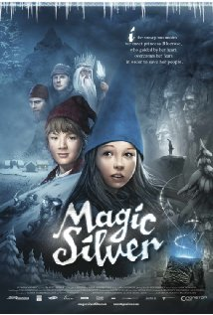
Idea 2 – Feature films
Magic Silver
Norway, 2009, 82 mins
A young girl chases a mysterious fox through a secret door and into a subterranean wonderland to retrieve her stolen train ticket.
*Not got a great rating though!

Slide 9
Other feature films…
Tales of The Night (2011)
How to Train Your Dragon
Lemony Snicket's A Series of Unfortunate Events
Pan’s Labyrinth (too scary for younger kids?)
There will be other foreign films too, just gotta find them….!

Slide 10
Idea 3 – Tales of The Night + Story-making Workshop
Tales of the Night
French, Michel Ocelot, 2011, 84 min
This enchanting short film about a red balloon that befriends a little French boy is more than a joy to watch.
Useful links:
http://www.imdb.com/title/tt1828229/

Slide 11
Idea 3 – Tales of the Night -Concepts
History blending with fantasy
A round the world adventure
Fairytales and folklore
Silhouettes
Shadow puppets
Paper cutting
Light projection
Different cultures
Magical creatures and characters
Lyricism
Interweaving stories
A broken narrative (like Carroll’s nonsense narrative)

Slide 12
Idea 4 – Digital Story Telling Workshop + Short film/Clip
Red Balloon
Pesto (Pixar, 5mins)
Clip from Alice in Wonderland (2010) e.g. Proposal, Alice goes down the rabbit hole, enters Wonderland/Underland. We could start with this – talk about what makes it a good story/how its been reinvented.

